Slide 1
Energy Transformations

Slide 2
Class discussion
Write down what your definition of energy
What is an example of energy transference

Slide 3
How Will we Define Energy
As the ability to do work

Slide 4
Law of Conservation of energy
Energy can not be created nor destroyed, but transferred from one form to another

Slide 5
What is energy?
https://www.youtube.com/watch?v=CW0_S5YpYVo&feature=emb_title

Slide 6
Basic Forms of Energy
Potential energy
Energy at rest
Stored energy
Has the potential to move
Kinetic
Energy of motion
Movement=heat
More kinetic energy= hotter

Slide 7
Sim
http://phet.colorado.edu/sims/html/energy-skate-park-basics/latest/energy-skate-park-basics_en.html

Slide 8
Kinds of potential energy
Gravitational
Caused by a gravitational force that pull objects have on each other
Potential energy that increases with suspended height and mass
https://www.youtube.com/watch?v=62LKnm1PmIc
Elastic
Occurs when an elastic substance is stretched
Increases with distance stretched from normal position
https://www.youtube.com/watch?v=KC_KUKlKouQ
Chemical
Occurs when chemical bonds are broken to release stored energy
https://www.youtube.com/watch?v=NiqM3lVirkw

Slide 9
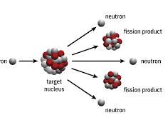
Forms of Energy
Nuclear
Powerful form of energy
Energy stored and released by an atom
Sound
Caused by vibrations
Needs a medium
Thermal
Measured by the overall kinetic energy in a system

Slide 10
Forms of Energy (cont)
Electric
Caused by the flow of electrons from a negative source to a positive source
Electrons flow from anode to cathode
Stops when there is no difference in charge
Mechanical energy
Sum of potential and kinetic energy
Occurs when work is applied
Shooting a basketball
walking

Slide 11
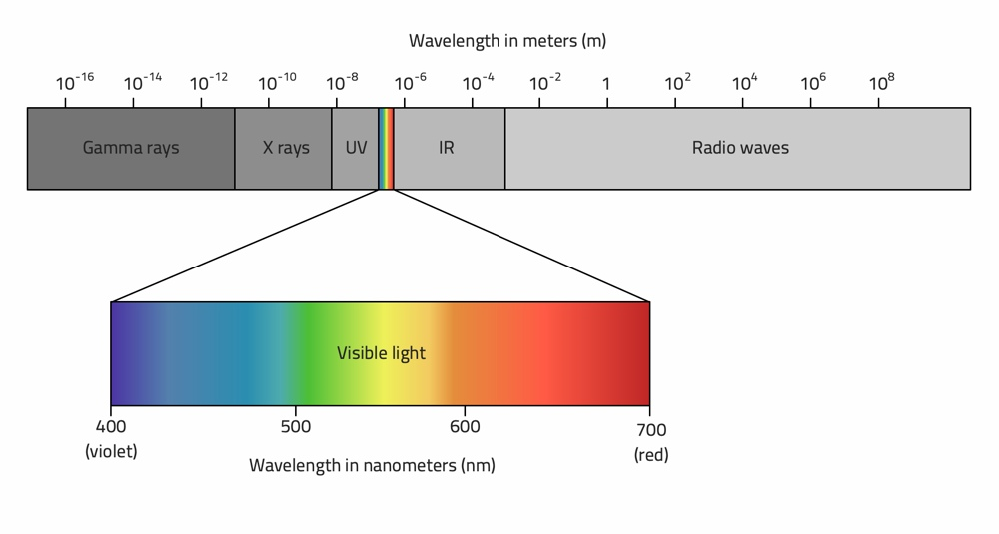
Electromagnetic Energy
Radiant energy
Radiation
Electromagnetic waves
Can be harmful
Electromagnetic spectrum
Radio waves
Least dangerous
Least radioactive
Visible light
What we see
UV
Harmful
Causes sunburns
X-rays
More harmful
Causes cancer if too much
Gamma rays
Deadly
Neutron stars

Slide 12
EM video
https://www.youtube.com/watch?v=RLykC1VN7NY

Slide 13
Newton’s cradle
https://www.youtube.com/watch?v=8dgyPRA86K0
BELLRINGER:

Slide 14
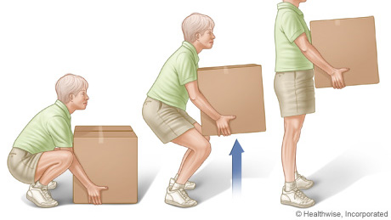
Work
Transfer of energy from one object to another through the application of force
Work is done when the object moves
Objects move in the direction that a force is applied
Objects can also do work
Bowling ball moving pins
Wrecking ball

Slide 15
Energy Transformations Part II

Slide 16
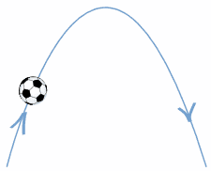
- At what point is the ball gaining kinetic energy - At what point is the ball gaining potential energy - When is potential energy and kinetic energy at their maximum - What force is causing the ball to come down

Slide 17
Friction
Force that opposes motion
Converts mechanical energy into thermal energy

Slide 18
Can Friction be Avoided?
Not really, it is everywhere
Aerodynamics
Smooth surfaces vs. rough
Traction

Slide 19
Energy Conversions
Energy can not be created nor destroyed, but transforms to other forms of energy
Real life example: carbon emissions from fossil fuels

Slide 20
Thermal Energy
All energy can be converted into thermal
Electric to thermal
Heater
Chemical to thermal
Heat from an acid
Propane for grills
Nuclear to thermal
Mechanical to thermal
Friction
Sound to thermal
Vibrations=kinetic energy=heat

Slide 21
Energy Conversions and
100% of the energy is not converted to the same thing
Leftover energy is released as heat
This is known as an exothermic reaction
Light bulbs
Cars and combustion engines

Slide 22
Chemical Energy
Uses energy acquired through natural processes to synthesize essential compounds
Example: glycolysis
Example II: photosynthesis
Example III: digestion
Organisms use the stored energy for various processes

Slide 23
Using Electromagnetic Energy
Remember EM waves encompass the entire electromagnetic spectrum
Phones use EM energy
How?
They send and receive microwaves, converting it into electrical energy, and then radiating that energy as an image/light

Slide 24
Using Electric Energy
Electric energy powers most of the modern day world
Batteries produce electric energy by harnessing chemical reactions to strip electrons
Appliances that are plugged into an outlet convert nuclear energy from a power plant into electrical

Slide 25
Optional video
https://www.youtube.com/watch?v=wGvKjkdbhYA

